Slide 1



Durand Inc. “Helping Individuals with Special Needs Learn and Grow” www.durandinc.org

Slide 2

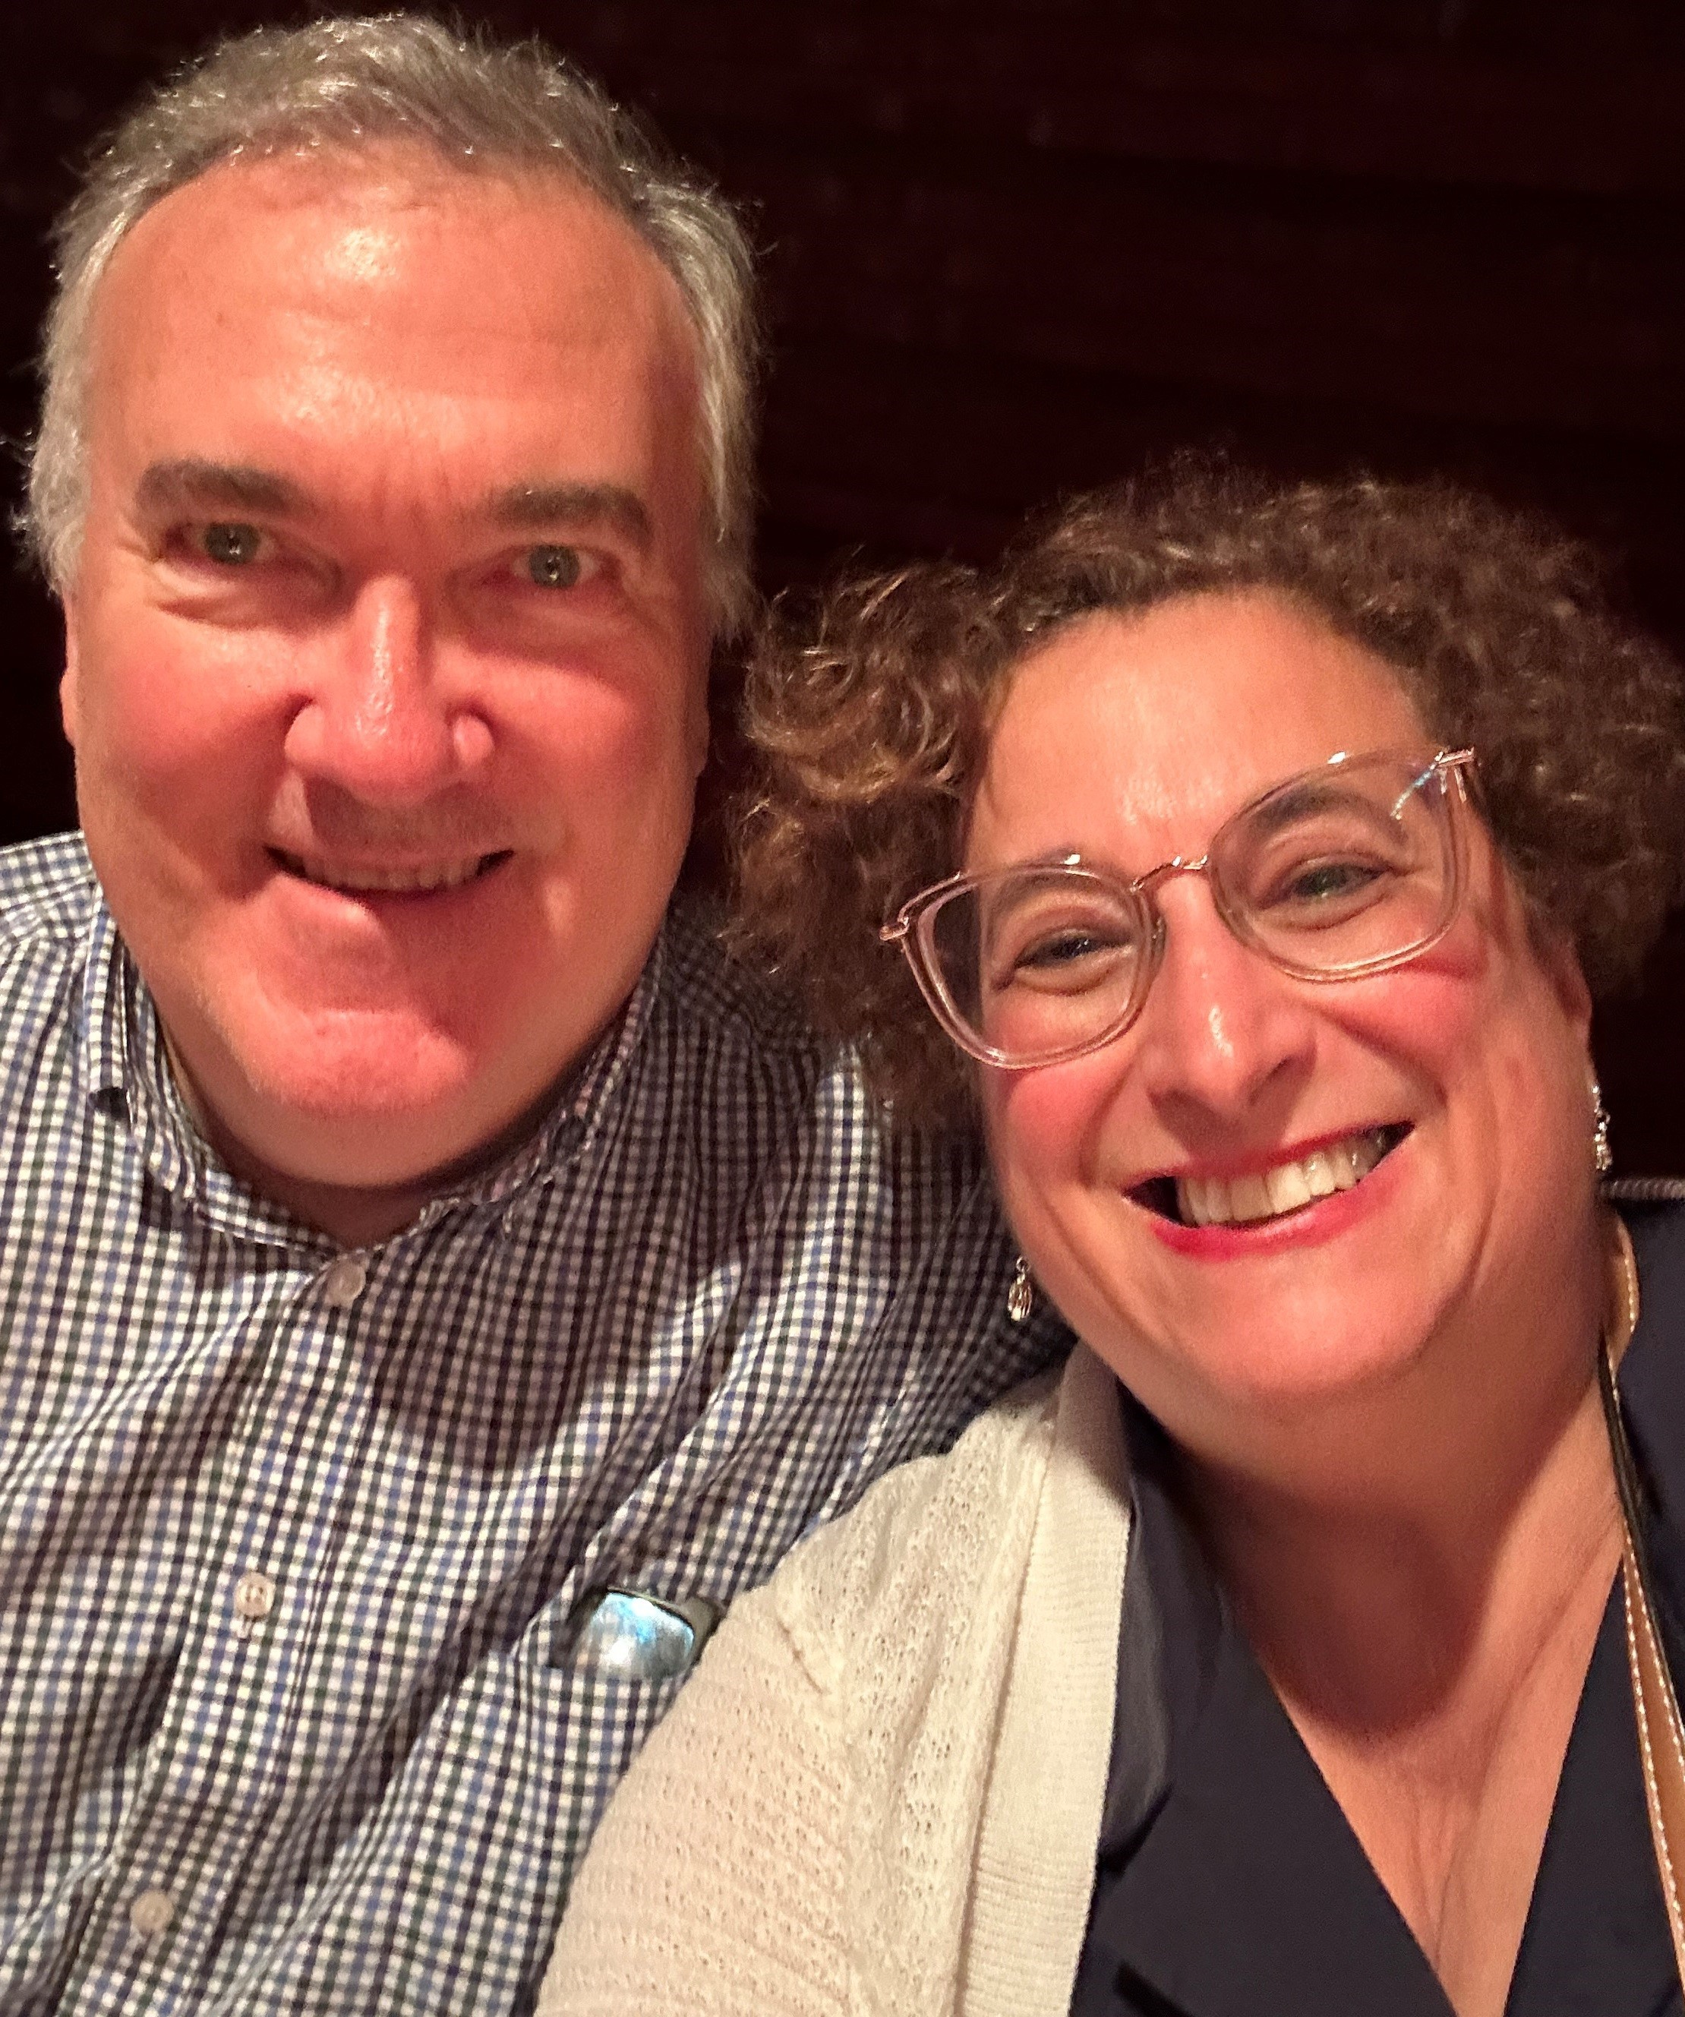
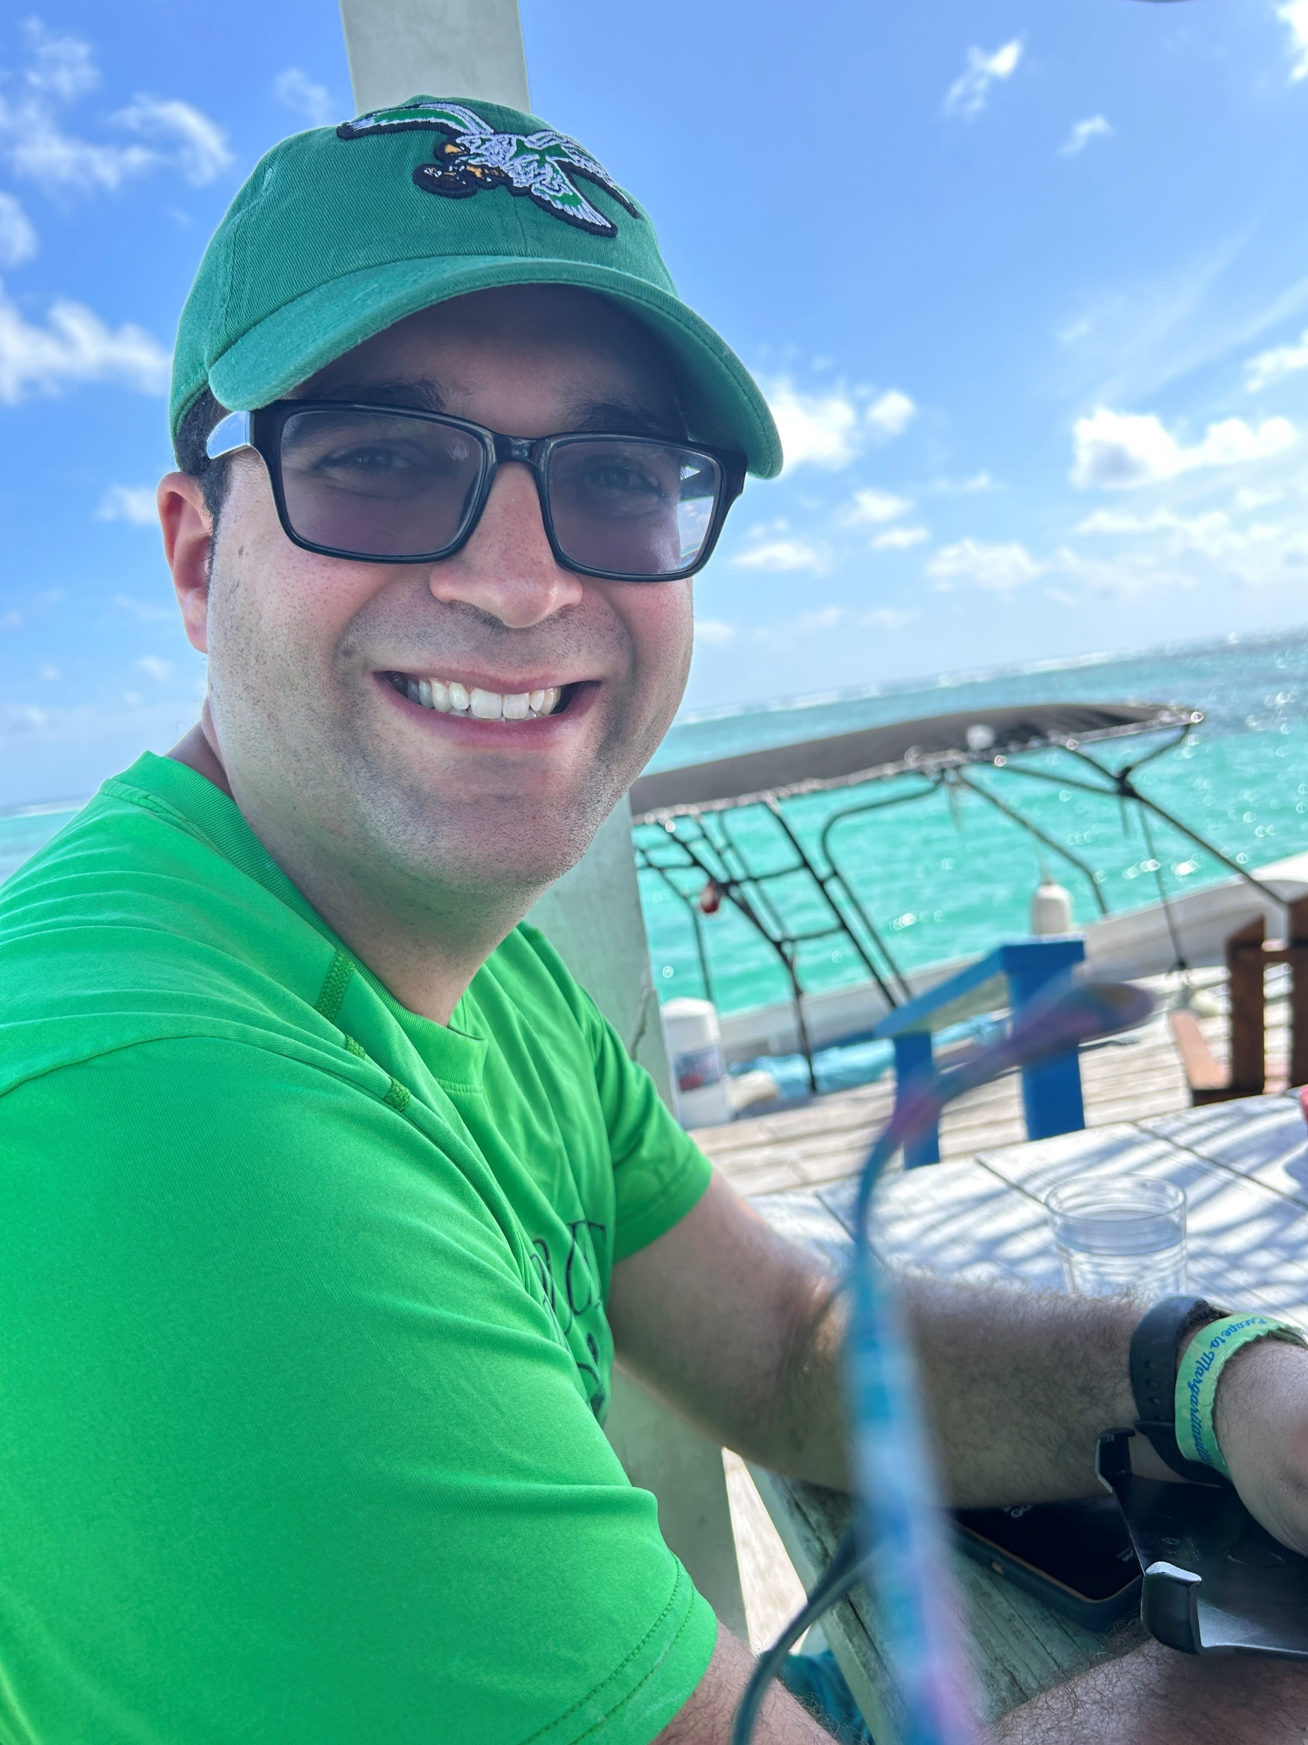
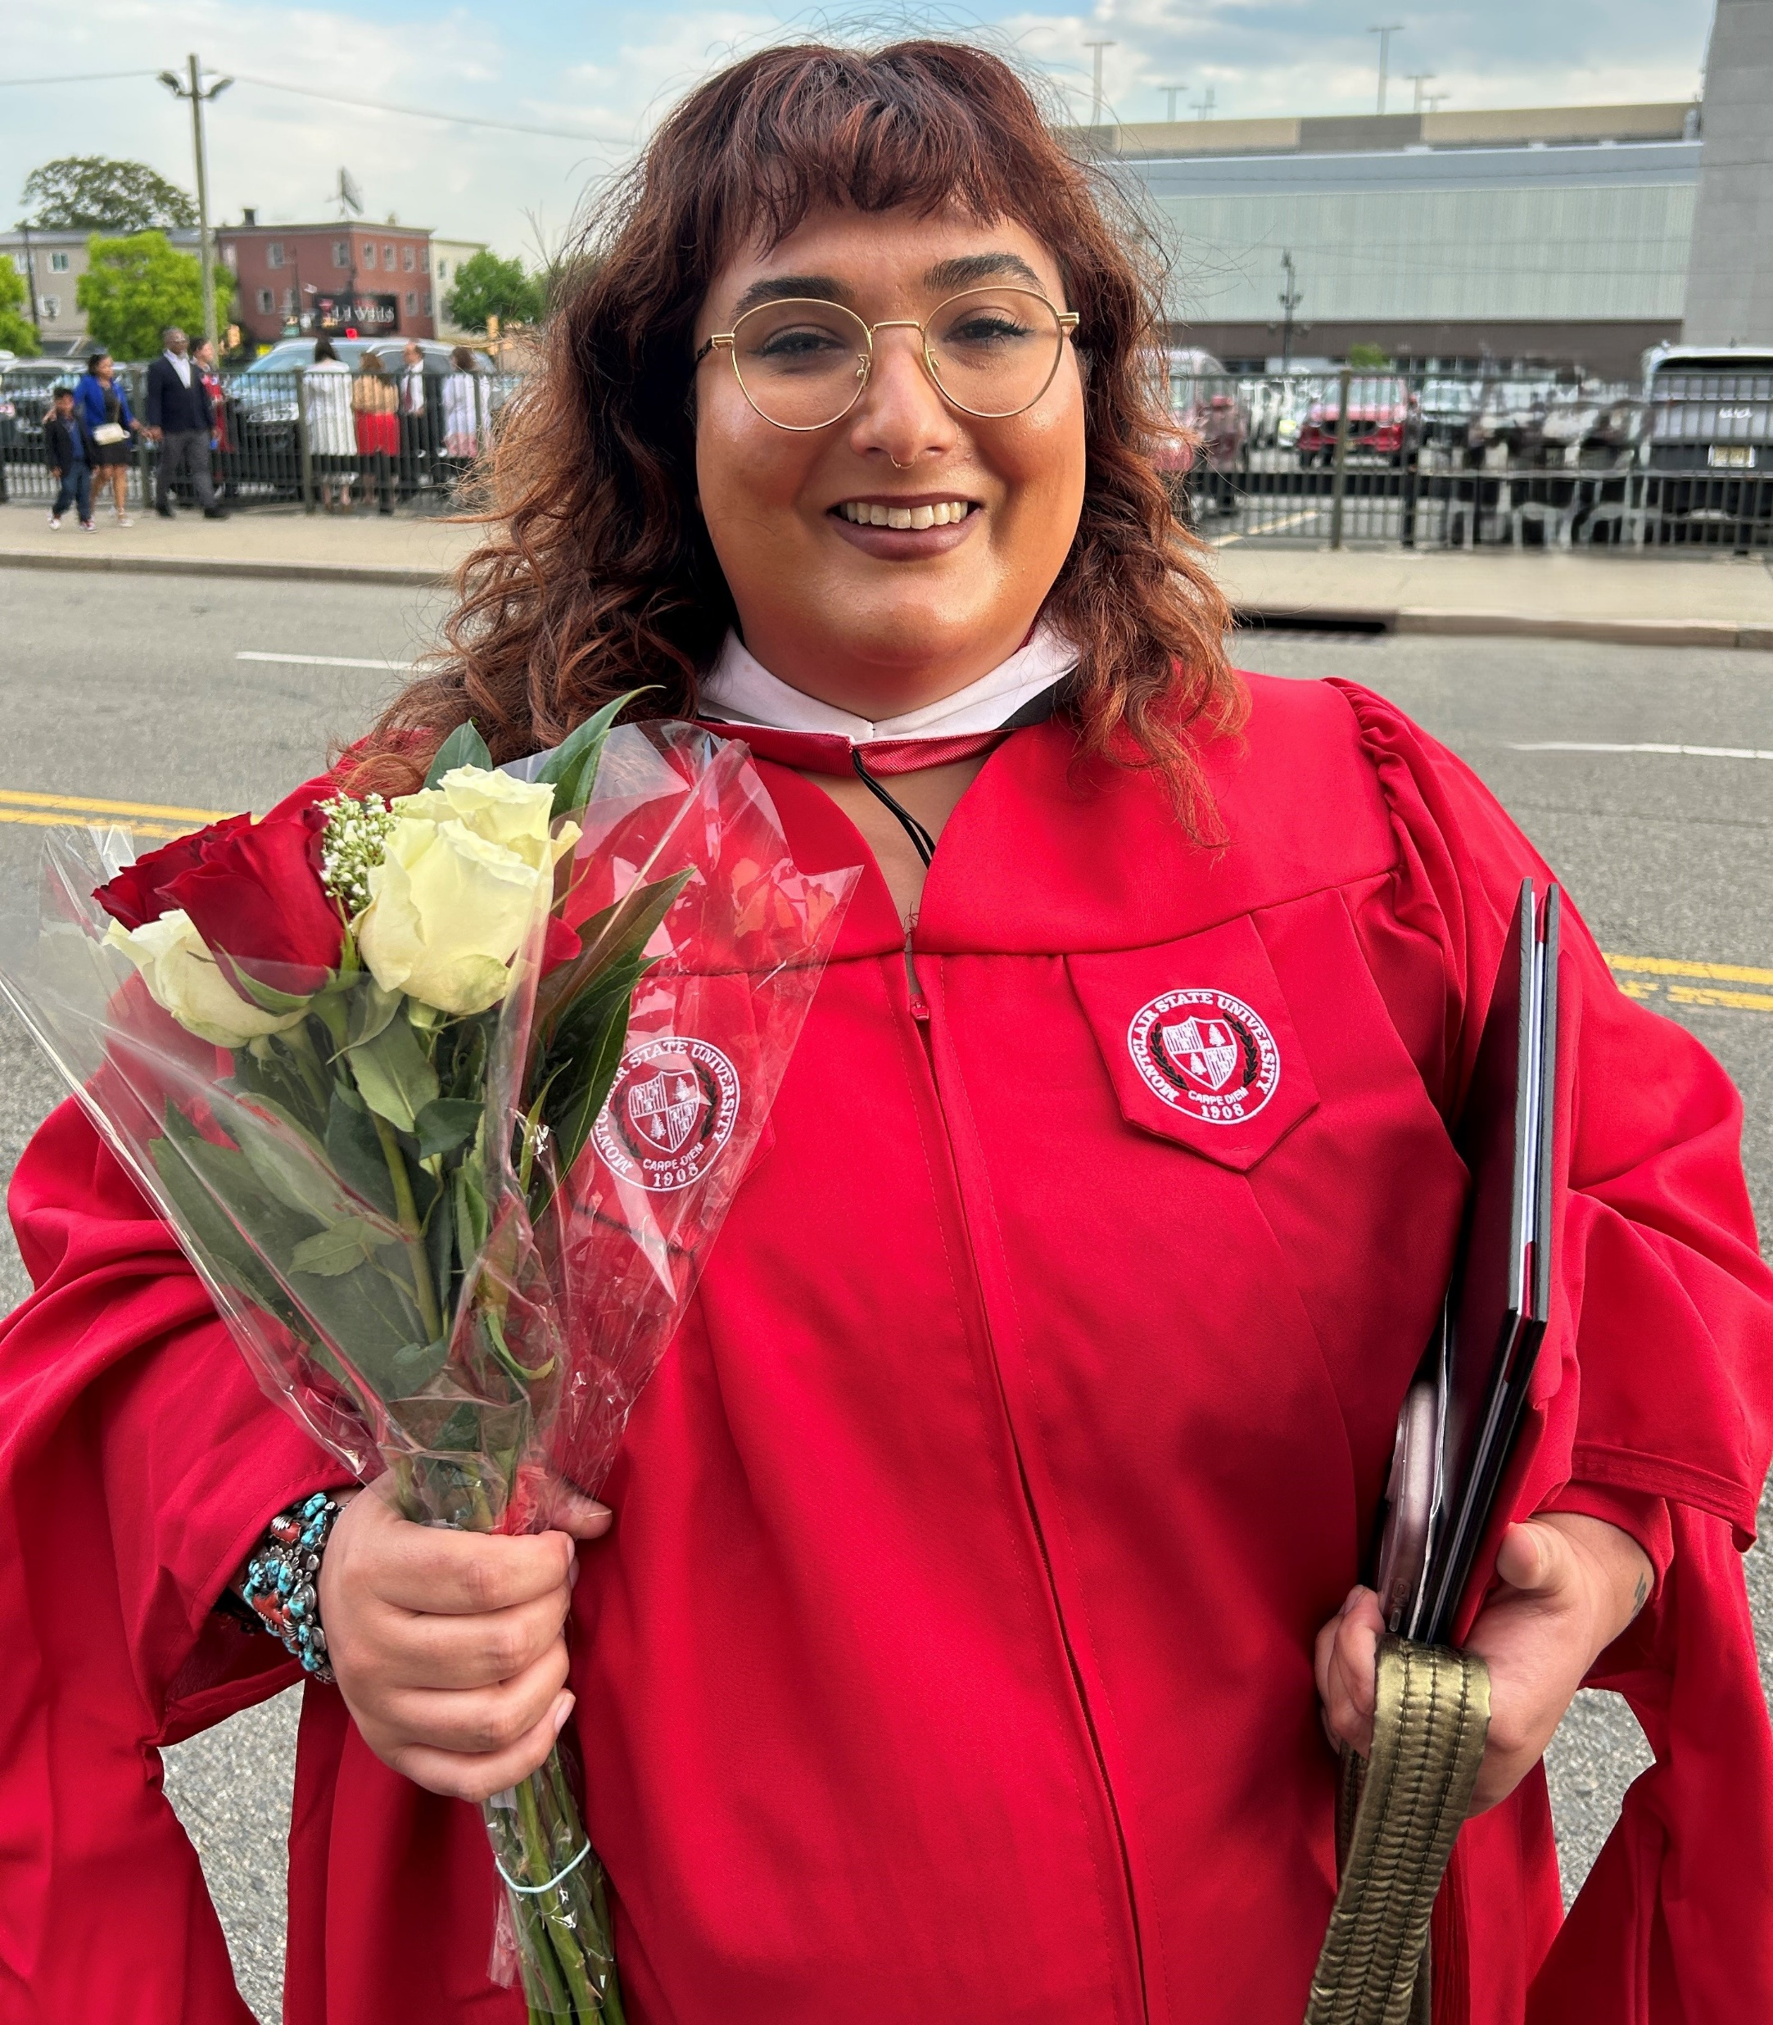
Laura Gaffney, Director of Family Support, Durand Inc.
Bachelor of Science/Business Admin. and Honors Studies from Villanova U. and Bachelor of Arts/Music Ed. from Rutgers U.
Married to Douglas, Master of Science/Coastal Engineering, P.E.
Parent of Andrew, age 34 with autism, Job Skills Cert. Camden Co. Coll. and Culinary Arts graduate of Soups and Sweets, Katz JCC and Emily, age 30, Master of Arts/Board Certified Music Therapist
TV, Radio and Podcast Appearances throughout S. Jersey as subject matter expert with lived experience
Member of ASA SW 532 for 30 years
Member of Diversability Team at the Haddonfield U. M. Church

Slide 3

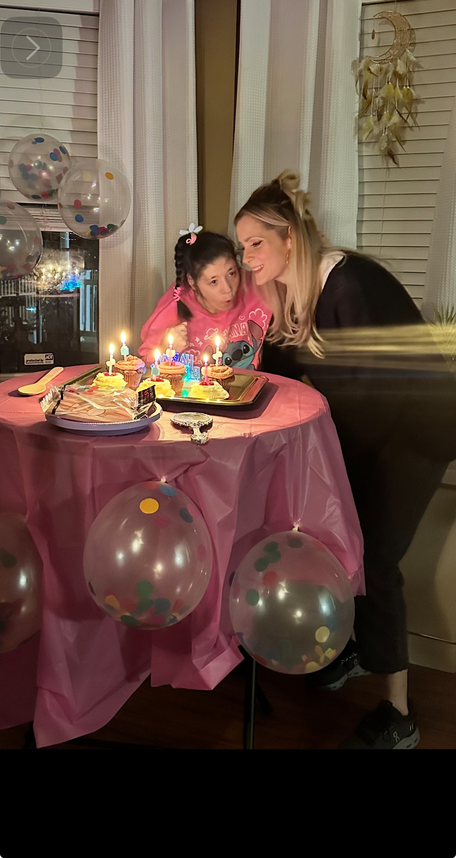
Family Support Programs
1:1 In-home and Community-Based Supports
Resources for Parents and Caregivers
Sibling and Parent-Hire
$21.11 base pay,
$28.11 acuity pay
Laura Gaffney
Director of Family Support
(856) 360-4800
l.Gaffney@durandac.org

Slide 4
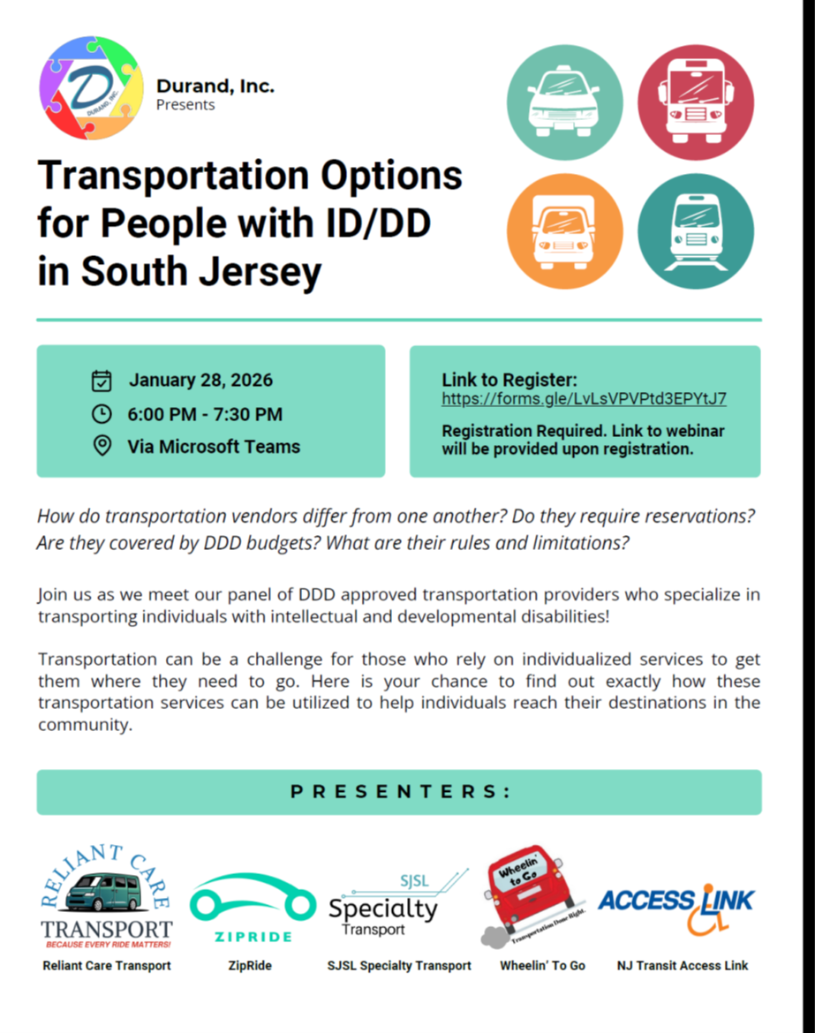
Transportation Options for People with ID/DD in South Jersey
Agenda for the Session:
6:00 pm – 6:45 pm Panelists’ Presentations (approx.5 minutes each)
6:45 pm – 7:15pm Moderated Q&A from questions previously submitted
7:15 pm – 7:30 pm Open Q&A
*The webinar is being recorded and will be available
on our website in the near future.
Website: www.durandinc.org

Slide 5

Because Every Ride Matters!
Dedicated Driver Service (D2D)
Managed Uber/Lyft
NEW: Family Driver Program
Match your loved one with a consistent, background-checked driver for reliable, scheduled transportation to day programs, work, or community activities.
We handle all payment processing for Uber and Lyft services. No out-of-pocket costs for you—we manage billing and track your mileage budget.
Family members/friends can now be compensated for driving their loved ones to activities—turning caregiving time into recognized, paid work.
Perfect for families seeking dependability and routine
Seamless rideshare without the hassle
DDD-approved service
"We wouldn't have been able to get through the Acumen process without Nathaniel. He has been such a great help."
Phone: 201.266.3023
Email: admin@reliantcaretransport.com
— Satisfied Parent
Web: reliantcaretransport.com

Slide 6

Wheelin’ to Go
Schedule set for the ISP Plan Year, contact if cancelling
Accepts DDD Budget and Private Pay options.
No wheelchair availability,
Destinations limited to the following programs/job sites:
Abilities Solutions
All In 2gether
Interactive Kids
Kinsgsway
Life Steps
OTC Berlin
OTC Burlington
TOPS
Contact Info.: Michelle Melloni, (609) 313-8556, mmelloni@wheelintogo.com

Slide 7
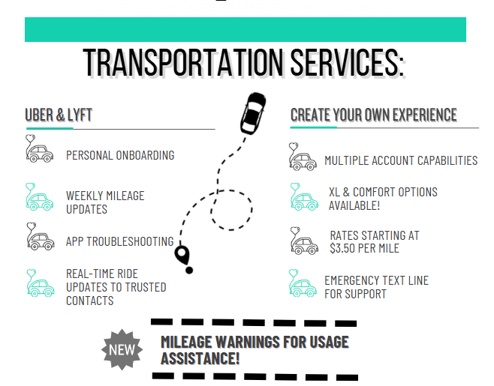



Slide 9

Larkey of Access Link will present their own slides and be allowed a 15-minute timeslot as a public service.

Slide 10
Does Wheelin' To Go run on Sundays?
Which transportation providers accomodate wheelchairs?
Can you include the wait list and pickup/dropoff time windows when discussing each option? Thank you!!
Are out of state trips to NYC with Uber allowed?
is zipride a reliable form of transportation for my son?

Slide 11
How do you calculate miles when using Uber/Lyft? Is there a boarding fee? Do you provide an assigned staff to individuals? Are you enrolled with Acumen?
Are aides provided?
Does your transportation company pick up at the family home? What are the limitations that the company can not do for the adult with DD? What is your company capable of doing for the adult DD? Do you provide personal service for the client? Helping & assisting them?
Safety/vetting of drivers

Slide 12
Are support coordinators supposed to help individuals figure out transportation issues? transportation
Are you able to get reviews on these companies?
How does this system work?
How does your organization manage transportation mileage that rolls over toward the end of the service year? Additionally, do any unused rollover miles expire, or are they carried forward into the next service period?
Easier application form for ID/DD Transportation Access

Slide 13
How reliable are these transportation vendors to take a special needs child from school to an after care center or an ABA center? How do they communicate with the parent?
Travel Training options
How does zip ride select drivers from Uber to transport their special needs adults.
What options are there for 3-18 year olds?
Interested in learning about door to door service for work transportation

Slide 14
Specifically interested in wheelchair transportation in south jersey
Are there wheelchair accessible options?
Will transportation prices be increasing this year

